Slide 1
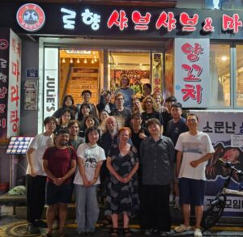
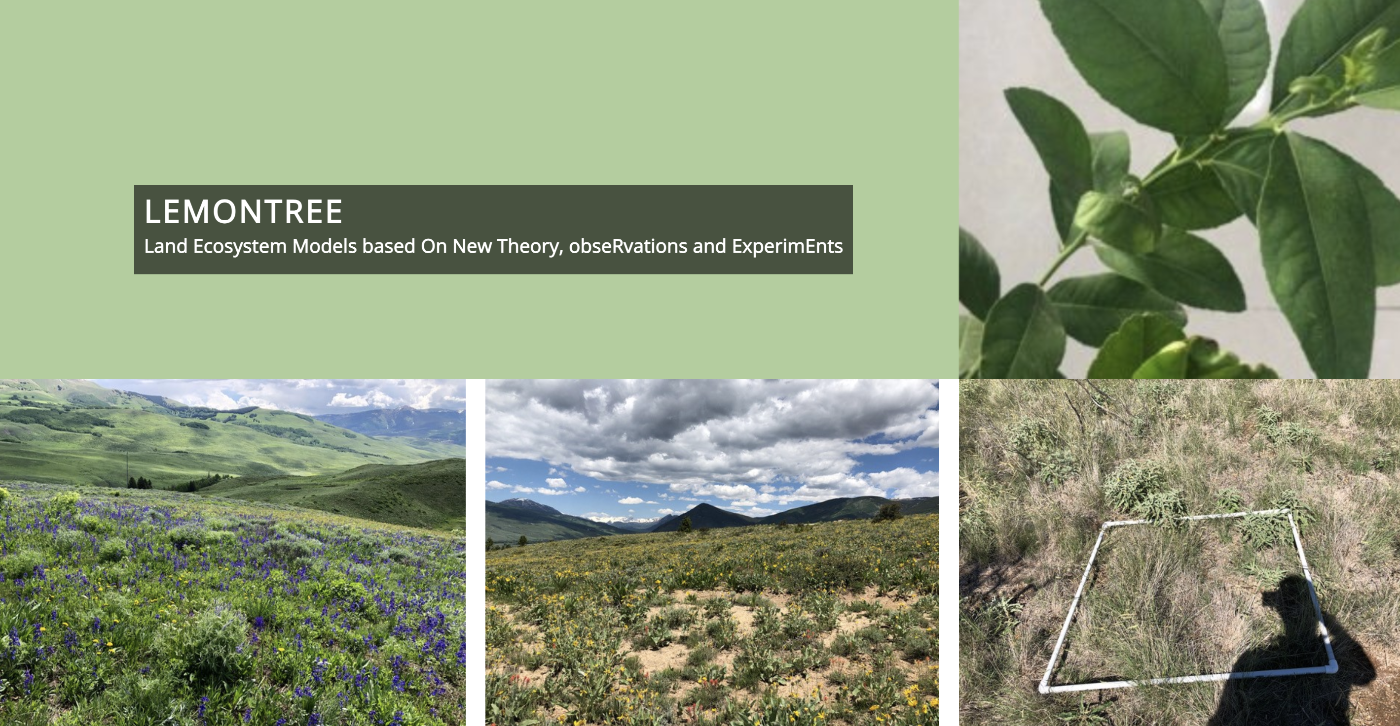
2025 LEMONTREE annual meeting in Seoul

Slide 2
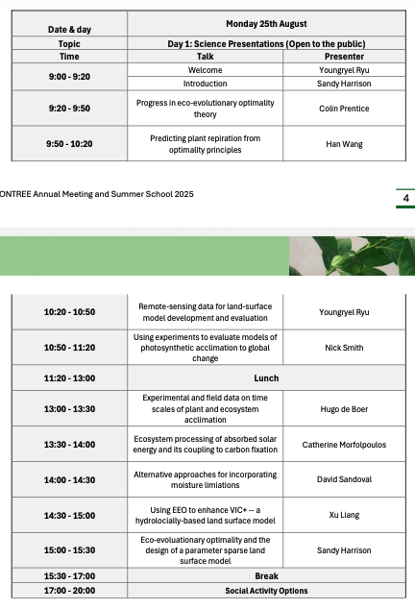
Day 1: open symposium

Slide 3
Day 2-3: working group discussions
WGA: Leaf area dynamics and carbon allocation
WGC: C, N and P cycles synthesis
WGE: Ecohydrology
WGF: Fire-vegetation interactions
WGDT: Function diversity theory and modelling
WGVD: Vegetation dynamics
WGLC: Lemontree-CONCERTO integrated implementation
WGIC: Implementation and coordination

Slide 5
PhUnFETTy tasks
NP meta-analysis (WGC)
P review (WGC)
Symbioses perspective (WGC)
Optimal trait coordination (WGDT)
Vegetation dynamics with different coordinated traits (WGDT)
Nutrients-LAI connection (WGDT/WGA)

Slide 6
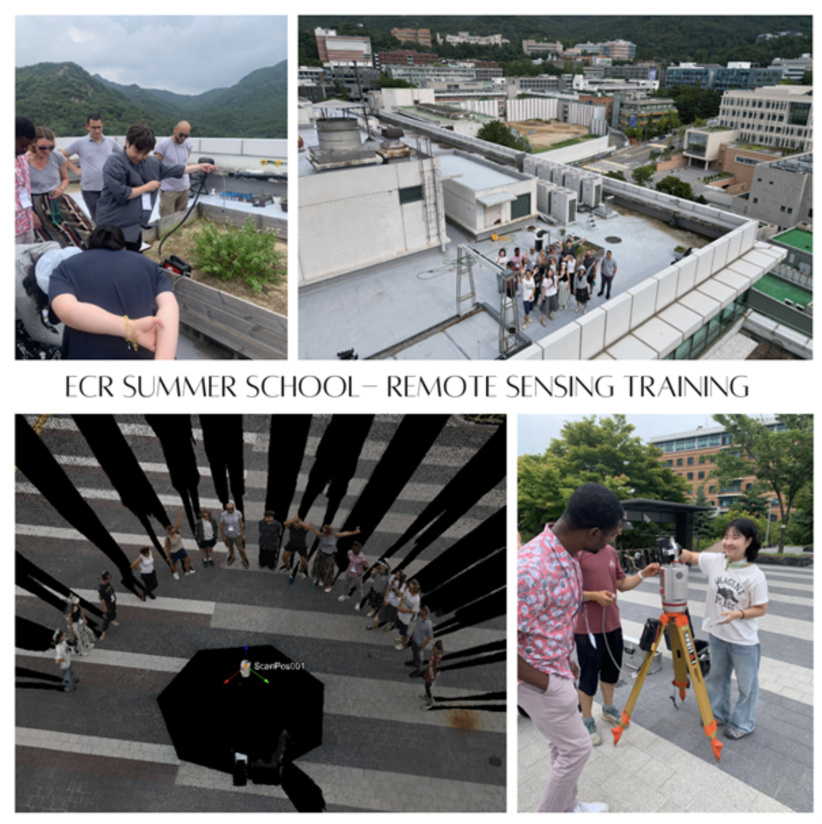
Day 4-5: summer school

Slide 7
